Slide 1
Pokédex
Vasyl Bodna
Willie Lui

Slide 2


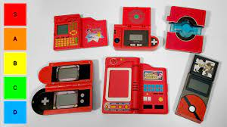
Beginning
We decided to make a Pokédex for the first generation of Pokémon.
We had the basic information:
Pokémon number
Name
Picture

Slide 3
Functions
Display
Search
List
More Information

Slide 4
Display
Will let you scroll through the list of Pokémon one by one
The name and number will be displayed along with the type the Pokémon is
The GUI will display an image of the Pokémon and there are two buttons (left and right) that when clicked will allow us to go through the list

Slide 5
Search
This function will let users search through the list of Pokémon
Once they input a string the information will be put into a try-catch block that will check if it is a number
Once it is determined whether or not it is a number it will try to it will try to get the information if it exist and display it
If it doesn’t exist then it will just display an error message

Slide 6
List
There will be an additional button that will let the user view the Pokédex in another form
They will be able to view the information of Pokémon in a list
The user will be able to scroll through the list of Pokémon
There will be a button that the user can press that will bring them back to the normal display

Slide 7
More Information
There will be an additional button that the user can press
It will bring the user to another screen that will display more information like weaknesses to other types

